Slide 1
Responsive Frontend
Development

Slide 2
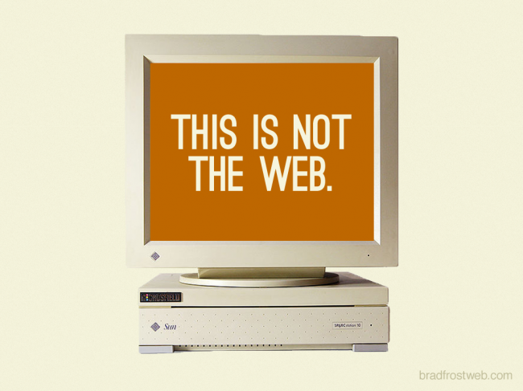

Slide 3
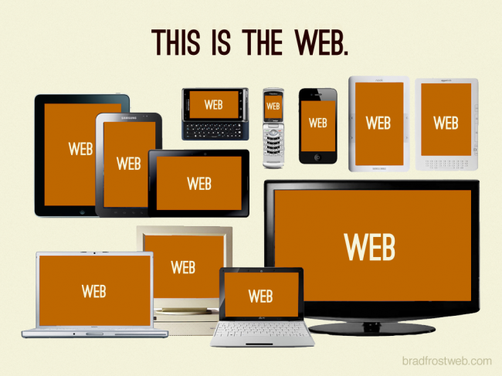

Slide 4
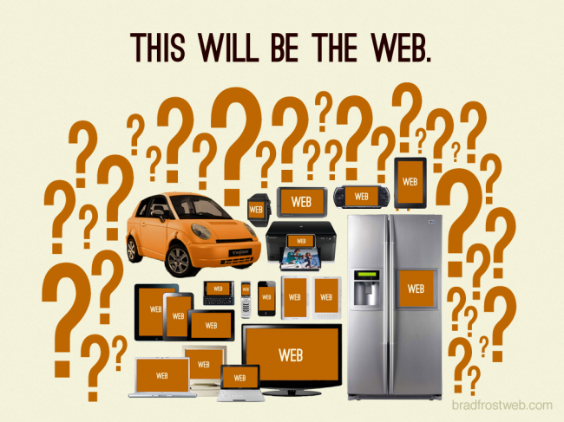

Slide 5
Fixed VS Fluid Layouts
Fixed Layout ?
Fluid/Elastic Layout ?

Slide 6
Fixed VS Fluid Layouts
Fixed Layout
Many Absolute Pixel Heights/Widths/Margins
Liquid/Fluid/Elastic Layout
Many Percentages, Auto Heights/Widths/Margins

Slide 7
Responsive VS Adaptive
Responsive?
Adaptive?

Slide 8
Responsive VS Adaptive
Responsive
One fluid Layout for multiple viewport sizes
Adaptive
Multiple fixed Layouts for multiple viewport sizes

Slide 9
Responsive Web Development
Looks great on
Mobile devices
Desktop devices
Responsive
= Different CSS declarations for different
browser widths
Media Query find out, what browser width is being used

Slide 10
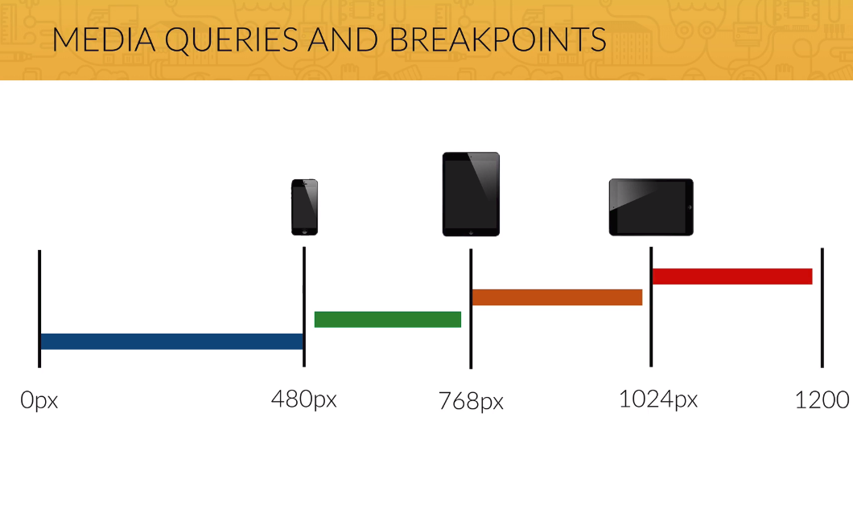

Slide 11
Media Types
Screen:
Desktop, Tablet, Smartphone
Print:
Printed Versions – also print preview of a site
TV:
Television, Smart-TV
Handheld:
Monochrome Handhelds
Braille, Embossed
For blind people devices

Slide 12
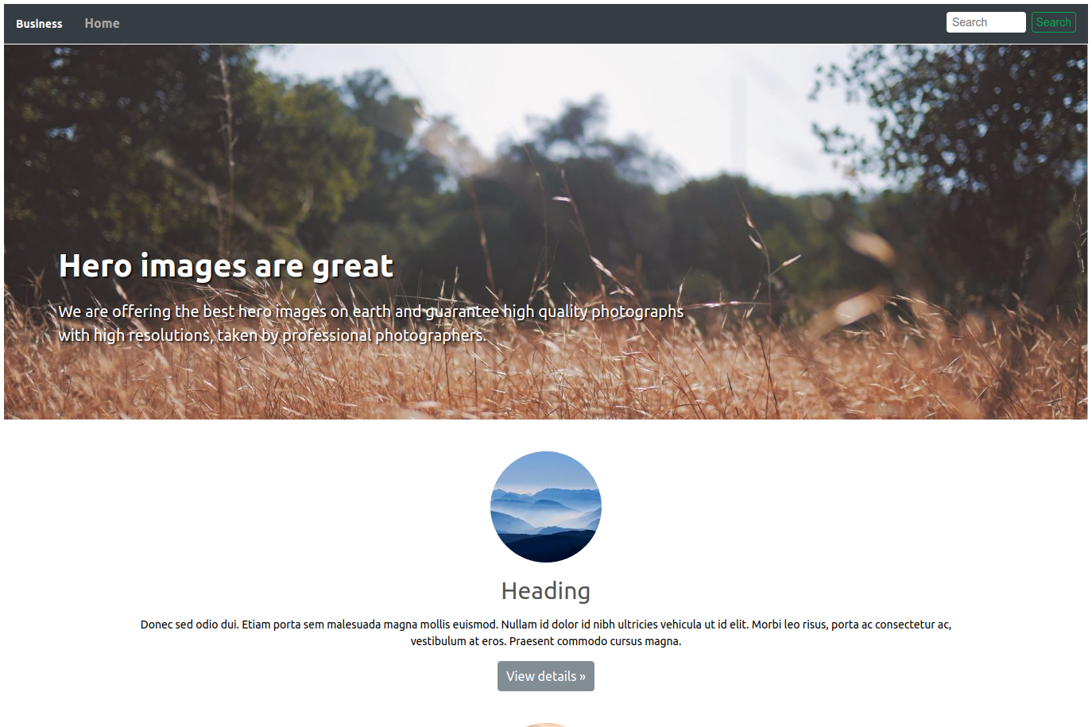
Task: Make this design responsive

Slide 13
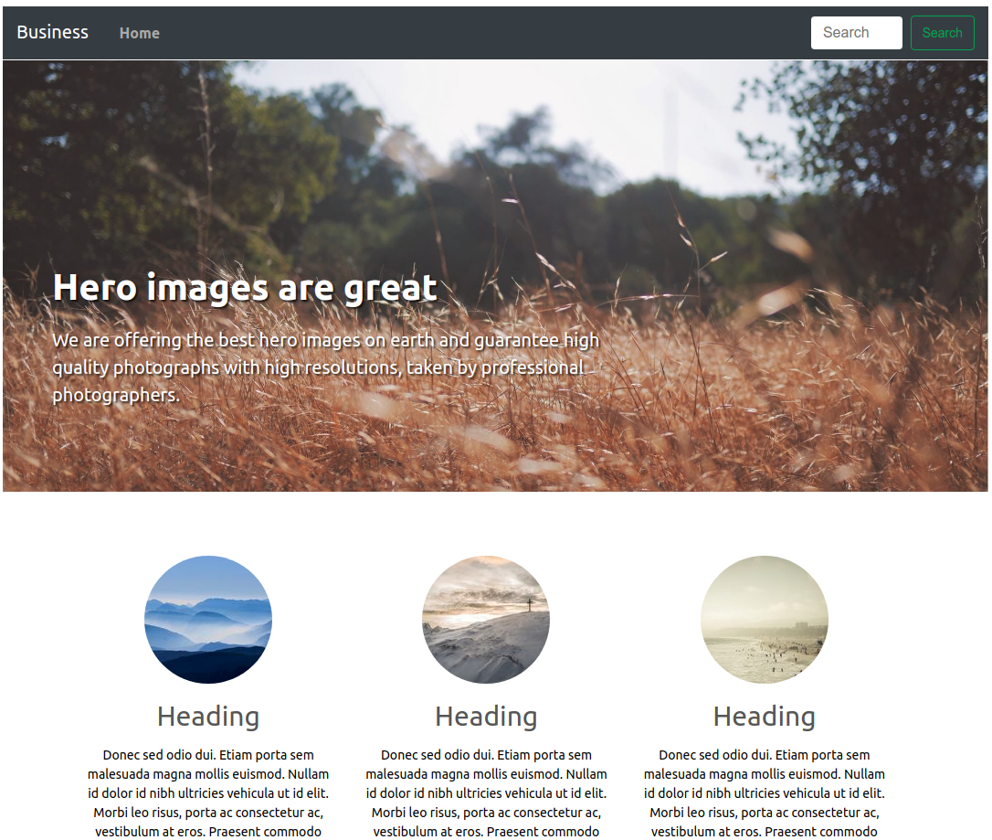
Projections:
Desktop / Big Tablet
(1/2)

Slide 14
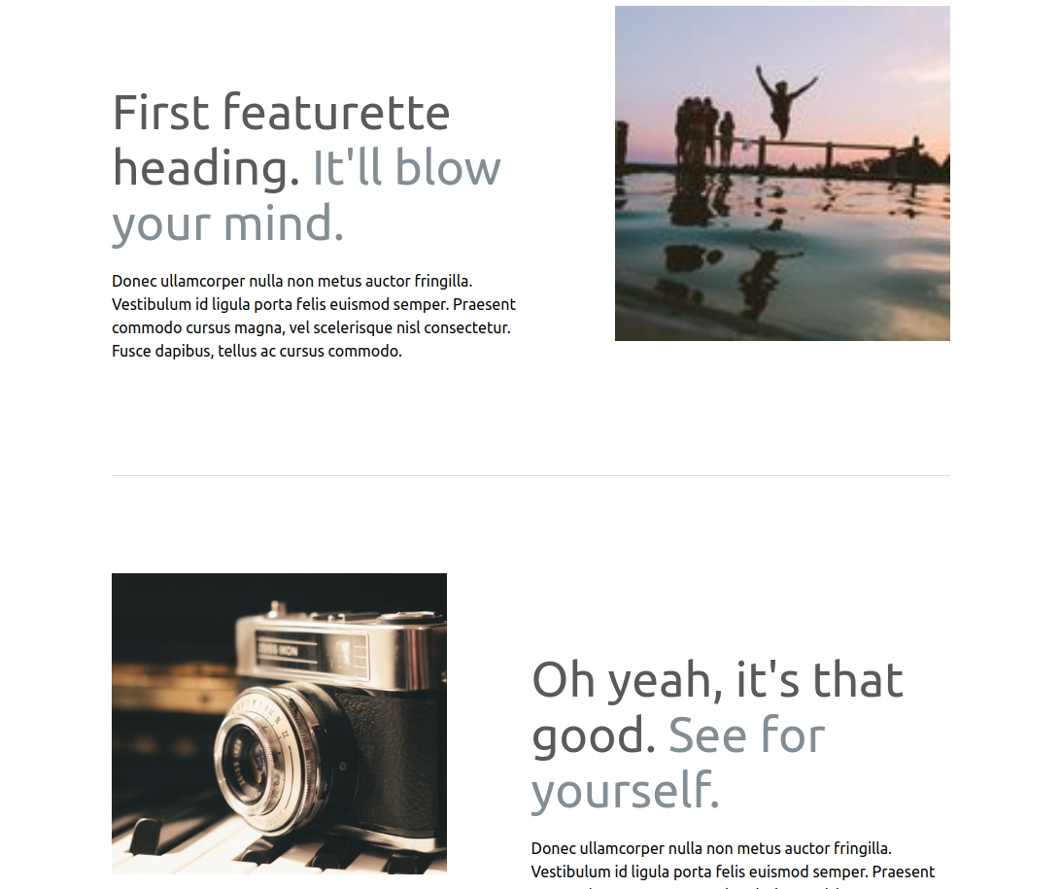
Projections:
Desktop / Big Tablet
(2/2)

Slide 15
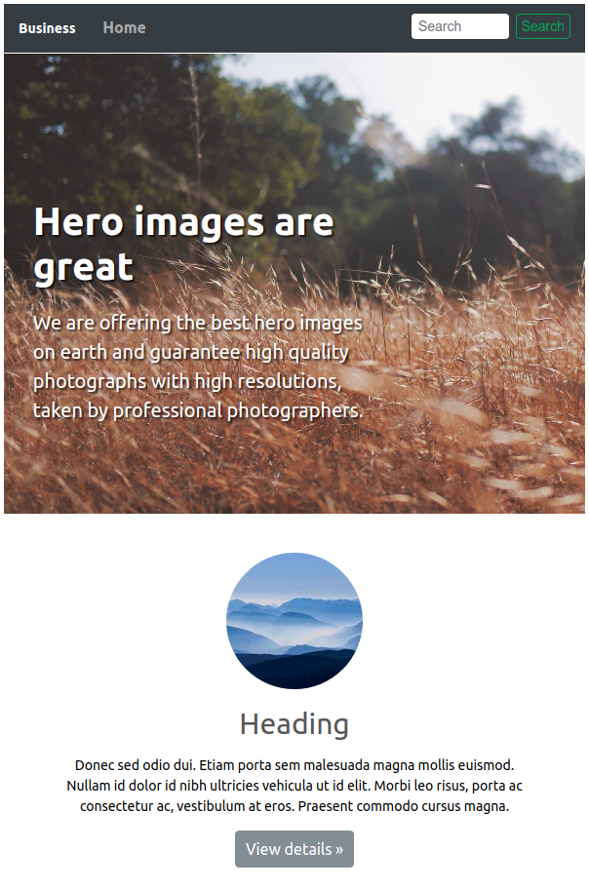
Projections:
Big Phone / Small Tablet (1/2)

Slide 16
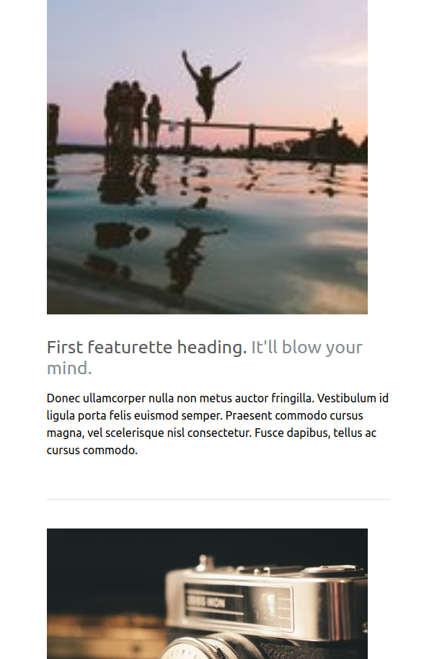
Projections:
Big Phone / Small Tablet (2/2)

Slide 17
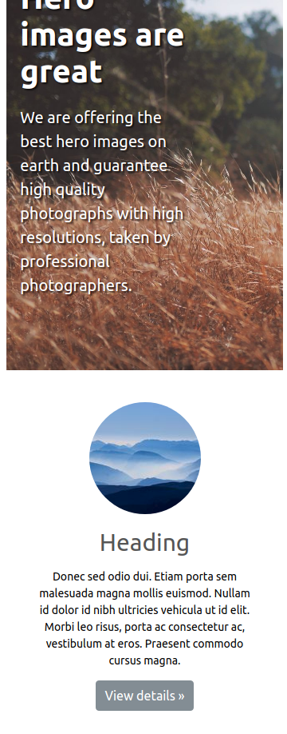
Projections:
Small Phone (1/2)

Slide 18

Projections:
Small Phone (2/2)

